Slide 1
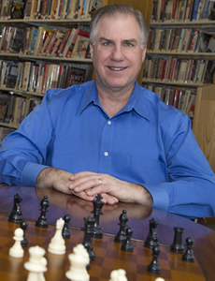
3D Printing The Networking Process
Central Connecticut State University Institute of Technology and Business Development November and December, 2015
Presented by Chip Janiszewski

Slide 2
PREFACE: The Networking MISCONCEPTION
Most people join Chambers/Organizations to GROW THEIR BUSINESSES
Networking Meetings – PROSPECTS??
The PROBLEM…
REALITY – Networking Definition: The PROCESS of Developing Win-Win RELATIONSHIPS…
The MEETING is JUST a PART of it…
The POTENTIAL…

Slide 3
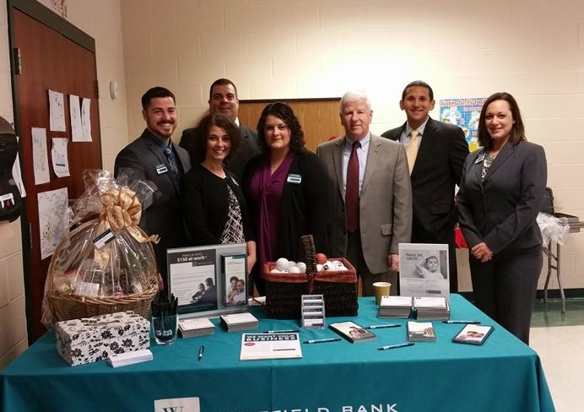
NETWORKING
The PROCESS of Developing
Win-Win Relationships
Foundation
Preparation
Step by Step

Slide 4
RELATIONSHIPS
Drive the
WORLD…
Strive to Make Your Relationships
WIN – WIN!

Slide 5
WIN – WIN RELATIONSHIPS ARE…
The Foundation for a Happy Life
Family
Friends
Health
Consumerism
SUPPORT...
The Foundation for a Successful Career
Employment
Clients
Vendors
Business Associates
Strategic Alliances
Masterminding

Slide 6
The FOUNDATION of the SUCCESSFUL ENTREPRENEUR
Positive Mindset
I AM IN CONTROL and I CHOOSE to be POSITIVE
Therefore, I DO NOT BLAME or COMPLAIN
I Express Gratitude
Unconditional Giving
Personal:
A WRITTEN “Definiteness of Purpose” (Napoleon Hill), Vision and Why
A WRITTEN Personal Strategic Plan
Daily Action
Ongoing Personal Development
Win – Win Relationships…

Slide 7
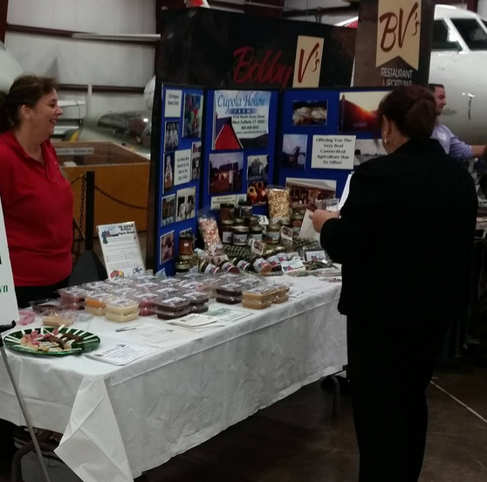
NETWORKING
The PROCESS of Developing
Win-Win Relationships
Foundation
The Networking Misconception
Networking Definition
The POSITIVE YOU!
RELATIONSHIPS you HAVE Family Friends Acquaintances Professional
TRUST!!
Networking Potential: 6 degrees
Entrepreneurs
Unconditional GIVING
Mindset - Purpose - Why
Strategy - Action

Slide 8
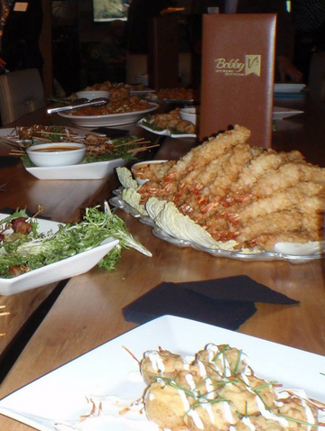
NETWORKING
The PROCESS of Developing
Win-Win Relationships
Preparation
WHAT do you REALLY DO?
For Whom?
Write down Prospects
Write down WHO knows them?
Set up a Tracking System
Networking Opportunities (Who):
Chambers - Organizations - Associations
Service Organizations
Professional
Networking
Online: Social Media & Meetup.com
Start Your Own!
Commercials & Presentations & Business Cards
Unconditional GIVING

Slide 9
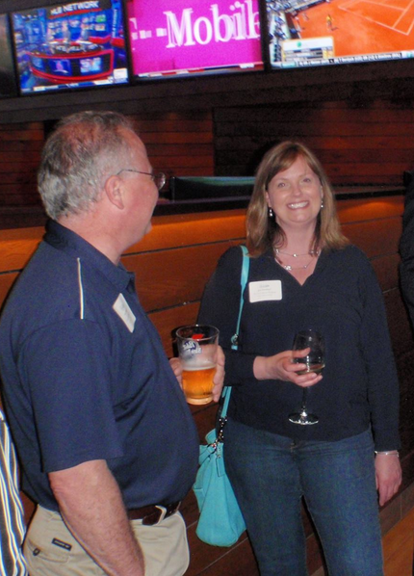
NETWORKING
The PROCESS of Developing
Win-Win Relationships
Step by Step
Networking Meeting:
Approaching: ASK & LISTEN
NO SELLING!!!
Commercials - Presentations
Purpose is APPOINTMENTS
Be a FACILITATOR
Testimonials
After Meeting:
SET or CONFIRM Appointments
Prepare
Update Contacts (Resources)
One to One:
Listen
Share (Business & Personal) - GAINS
Task List
SCHEDULE Follow Up
KEEP the PROCESS GOING!!!

Slide 10
NETWORKING
The PROCESS of Developing
Win-Win Relationships
Foundation
Preparation
Step by Step
Networking Misconception
Networking Definition
The POSITIVE YOU!
RELATIONSHIPS you HAVE Family Friends Acquaintances Professional
TRUST!!
Networking Potential: 6 degrees
Entrepreneurs
Unconditional GIVING
Mindset - Purpose - Why
Strategy - Action
WHAT do you REALLY DO?
For Whom?
Write down Prospects
Write down WHO knows them?
Set up a Tracking System
Networking Opportunities (Who):
Chambers - Organizations - Associations
Service Organizations
Professional
Networking
Online: Social & Meetup
Start Your Own
Commercials & Presentations & Business Cards
Unconditional GIVING
Networking Meeting:
Approaching: ASK & LISTEN
NO SELLING!!!
Commercials - Presentations
Purpose is APPOINTMENTS
Be a FACILITATOR
Testimonials
After Meeting:
SET or CONFIRM Appointments
Prepare
Update Contacts (Resources)
One to One:
Listen
Share
Task List
SCHEDULE Follow Up
KEEP PROCESS GOING!!!

